Slide 1
PointNet++: Deep hierarchical Feature Learning on Point Sets in a Metric Space

Slide 2
- Introduce a hierarchical neural network that applies PointNet recursively on a nested partitioning of the input point set - The network can learn local features with increasing contextual scales - Pointnet++ is able to learn deep point set features efficiently and robustly - The results significantly better than state-of-the-art have been obtained on challenging benchmarks of 3D point clouds
Key points

Slide 3
Introduction
PointNet: learn a spatial encoding of each point and then aggregate all individual point features to a global point cloud signature, an effective architecture to process an unordered set of points for sematic feature extraction
PointNet++: partition the set of points into overlapping local regions by the distance metric of the underlying space, apply PointNet recursively on a nested partitioning of the input set
Extract local features capturing fine geometric structures from small neighborhoods
Local features are further grouped into larger units and processed to produce higher level features
This process is repeated until features of the whole point set is obtained
The design of PointNet++ address 2 issues:
How to generate the partitioning of the point set
How to abstract sets of points or local features through a local feature learner

Slide 4
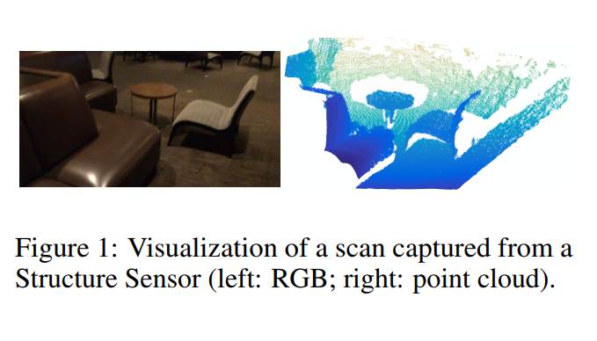
Figure 1

Slide 5
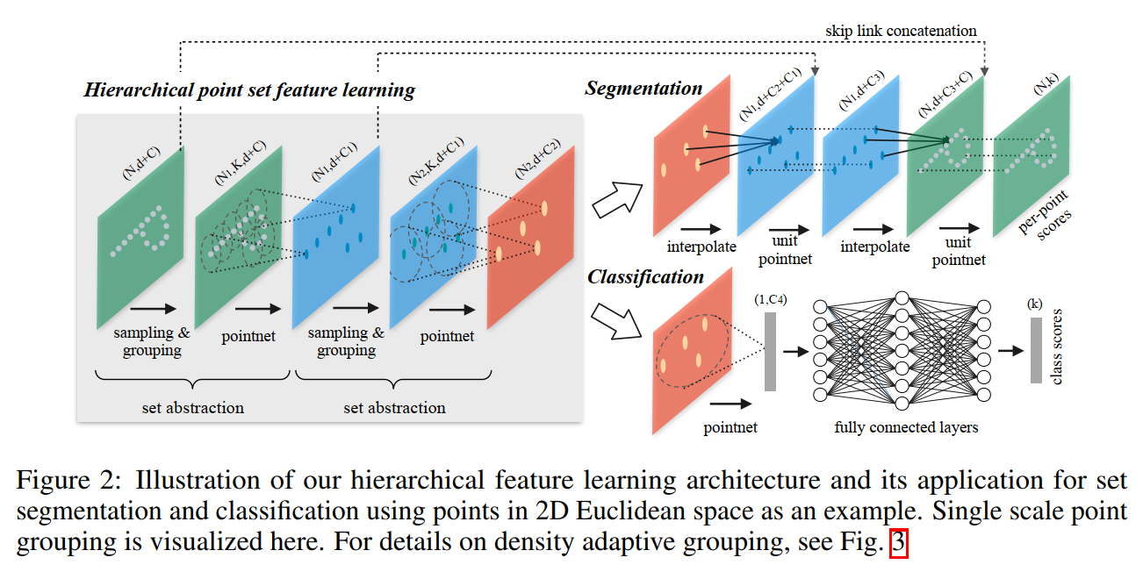
Figure 2

Slide 6
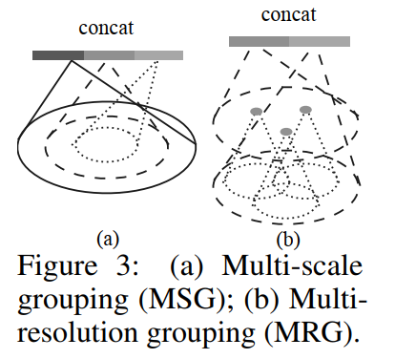
Method
Hierarchical Feature Learning
Partition the input point set into overlapping local regions
Extract local features with PointNet
Group these features into larger units progressively
2. Set abstraction layers
Sampling layer: uses farthest point sampling (FPS) to select centroids
Grouping layer: define local regions around centroids
PointNet Layer: Encodes local region patterns into feature vectors
3. Multi-Scale Grouping (MSG) and Multi-Resolution Grouping (MRG):
MSG: Applies grouping layers with different scales, capturing multi-scale patterns
MRG: More efficient, concatenates features from subregions and larger neighborhoods

Slide 7
Experiments
Experiment | Dataset | Result
Point set classification | MNIST (2D), ModelNet40 (3D) | PointNet++ outperforms PointNet and other state-of-the-art methods in classification tasks
Point set segmentation | ScanNet for semantic scene labeling | PointNet++ achieves higher accuracy than previous methods, effectively segmenting objects in 3D scenes
Non-Euclidean Metric Space | SHREC15 for non-rigid shape classification | PointNet++ captures intrinsic structures effectively, outperforming other methods

Slide 8
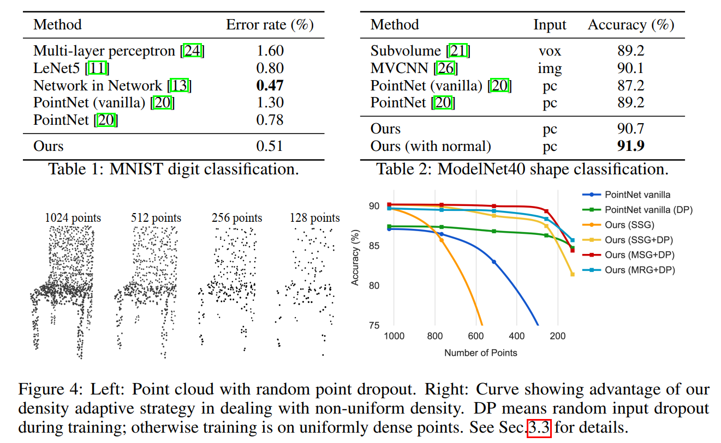
Experiments

Slide 9
Conclusion
Effectiveness: PointNet++ efficiently learns hierarchical features from points sets in metric spaces
Future work: Focus on accelerating inference speed and exploring applications in higher-dimensional

Slide 10
thank you

